Slide 1
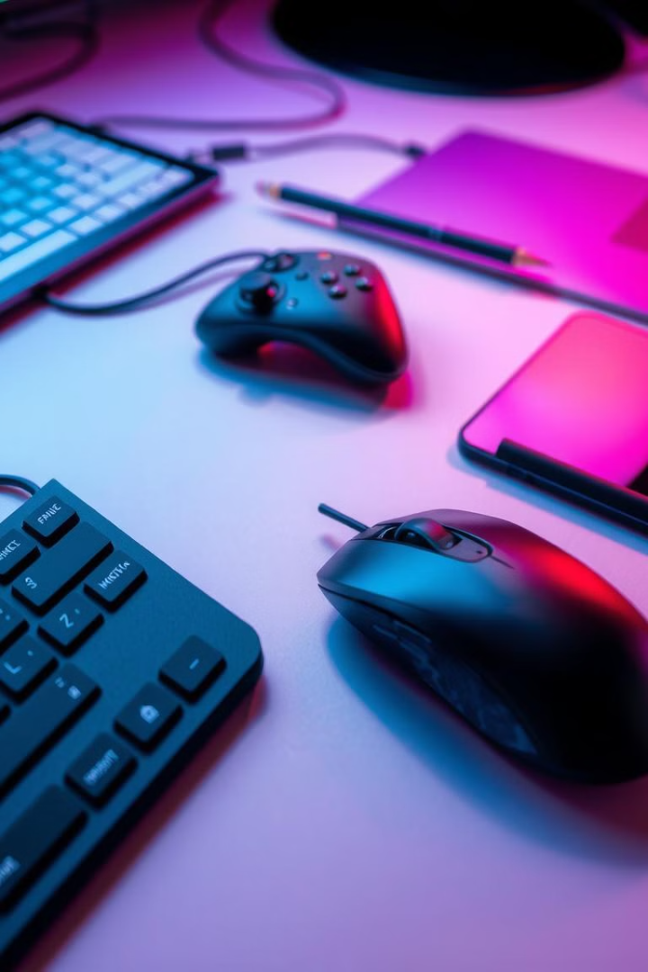

A Deep Dive into Input Devices
Welcome! This presentation explores the fascinating world of input devices. From keyboards to touchscreens, we'll examine how these tools allow us to interact with computers. Let's begin!
by Albir Ashfaq2

Slide 2
Keyboard: The Foundation of Input
Mechanical Keyboards
Membrane Keyboards
Ergonomic Keyboards
These offer tactile feedback and durability. They're favored by gamers and typists.
Membrane keyboards are affordable and quieter. They're a good option for everyday use.
These prioritize comfort and reduce strain. They're designed to prevent repetitive strain injuries.
Responsive keystrokes
Cost-effective
Improved comfort
Customizable
Quiet operation
Reduced strain
Durable build
Lightweight and portable
Split designs

Slide 3
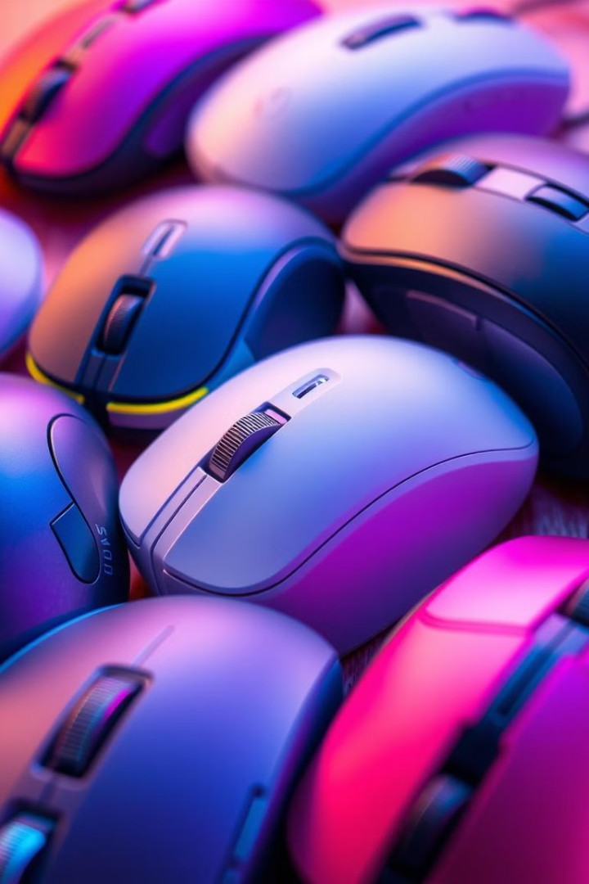
Mouse: Navigating the Digital World
Mechanical Mice
Optical Mice
These utilize a rolling ball for movement. They're known for their durability but are less precise than modern alternatives.
Optical mice use a sensor to track movement on a surface. They're more precise than mechanical mice.
Laser Mice
Trackball Mice
Laser mice offer even greater precision and can work on a wider range of surfaces.
These feature a ball that's controlled by your thumb. They're ergonomic and excellent for desktop use.

Slide 4
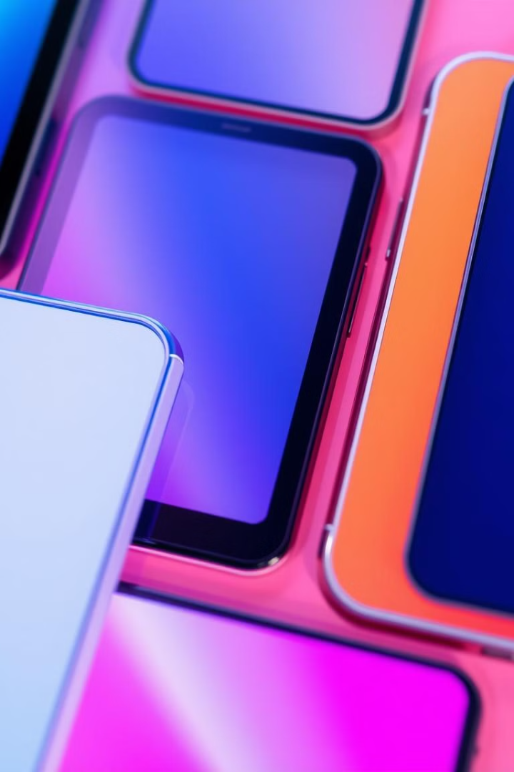



Touchscreen: Interactive Interfaces
Capacitive
Resistive
Responsive, accurate, and commonly used in smartphones and tablets.
Older technology, less accurate; works with gloves or styluses.
Projected Capacitive
Infrared
Highly accurate, multi-touch; used in high-end devices.
Precise and reliable, ideal for large-scale displays and public use.

Slide 5
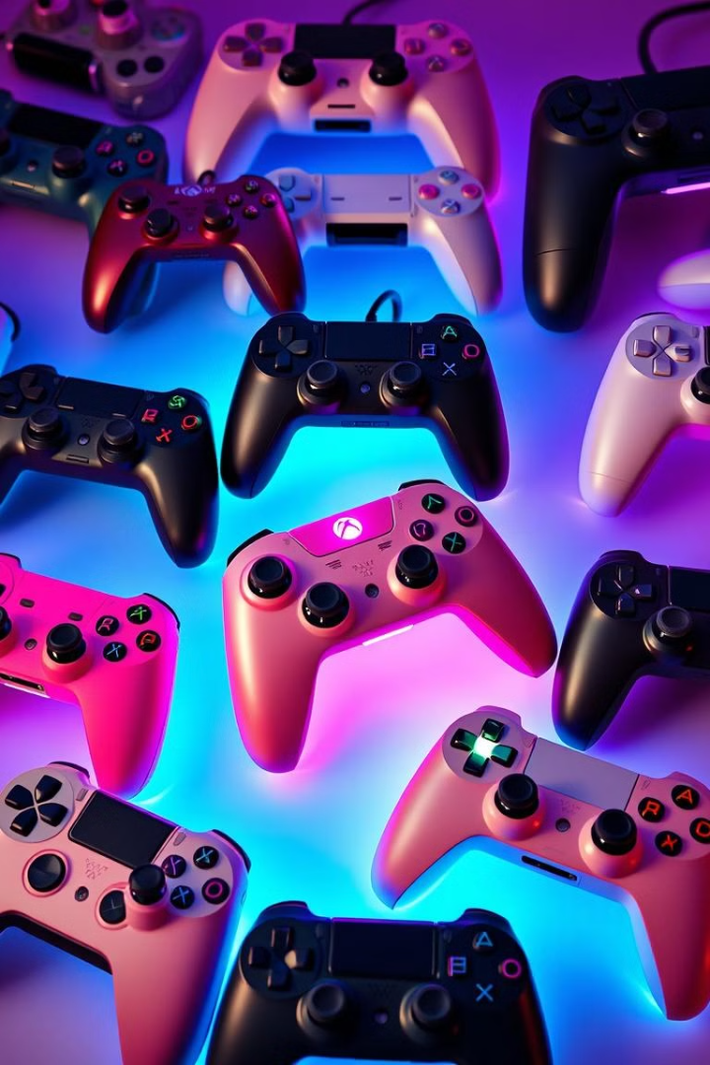
Gamepad: Immersive Control
10
2
Buttons
Analog Sticks
Standard button count; some have more.
Precision movement; crucial for gaming.
4
1
Triggers
D-Pad
Additional controls; often for shooting.
Directional input; retro games.

Slide 6





Joystick: Precision Control
Analog Stick
Provides smooth, continuous movement. Common in video games, flight simulators, and robotics.
Digital Joystick
Offers discrete movements in specific directions. Often used in arcade games and older flight simulators.
Force Feedback Joystick
Provides haptic feedback, simulating forces and resistance. Enhances immersion in flight simulators and racing games.
Dual-Stick Joystick
Features two joysticks for greater control. Ideal for 3D games and flight simulators.

Slide 7
Trackball: A Rolling History
Early Trackballs
1
Large, mechanical; often used with minicomputers.
Desktop Trackballs
2
Smaller, more ergonomic; common in office settings.
Portable Trackballs
3
Compact, lightweight; for laptops and travel.
Modern Trackballs
4
Advanced sensors; high precision, customizable.

Slide 8
Digitizer Tablets: Precision and Creativity
Early Models
1
Limited pressure sensitivity; basic functionality.
2
Pressure Sensitivity
Improved pressure levels; more natural feel.
Advanced Features
3
Tilt recognition; multi-touch capabilities.
4
Wireless Connectivity
Bluetooth; improved portability and freedom.
High Resolution
5
Increased resolution; improved accuracy; detail.

Slide 9




The Evolution of Input
Basic Input
1
Keyboards and mice
Touch and Gesture
2
Touchscreens, tablets
Immersive Control
3
Gamepads, joysticks
Precision and Creativity
4
Digitizer tablets, styluses
Input devices have come a long way. From simple beginnings to advanced technologies, they continue to shape how we interact with computers. The future holds even more innovative ways to control and create in the digital realm.

